Slide 1


Algorithms
Ziqi Wang (Ph.D. Student, UCLA ECE)
Dr. Luis Garcia (Research Computer Scientist, USC ISI)
wangzq312@g.ucla.edu lgarcia@isi.edu
UCLA CE Freshers Bootcamp 2020
We thank historical contributors: Tianmu Li, Santadeep Pal, Dr. John Lee, Dr. Rani Ghaida. Dr. Abde Ali Kagalwalla and Dr. Yasmine Badr. Some slides materials are based on Introduction to Algorithms by Cormen et al. and Algorithms, 4th Edition by Robert Sedgewick and Kevin Wayne

Slide 2
What is an Algorithm?
An algorithm is a well-defined computational procedure that takes an input and produces some output.
It is thus a set of computational steps that transform the input into the output.
Algorithm
INPUT
(problem)
OUTPUT
(solution)
x
1
2
3
4
5
y = x²
y
1
4
9
16
25

Slide 3
Agenda (Morning)
What sort of problems are solved with algorithms?
Common Data Structures in Programing
Queue, Stack, Linked List, Tree, Graph
Search Algorithms
Sequential Search
Time Complexity and Space Complexity
Binary Search [Exercise ]
Sorting Algorithms
Bubble Sort [Exercise ]
Insertion Sort
Selection Sort
Quick Sort
Merge Sort [Optional Exercise ]

Slide 4
Agenda (Afternoon)
Potential office hour 1:15 pm to 2:45 pm
Graph
Graph Basics
Breadth-first Search [Exercise ]
Depth-first Search
A Brief Introduction to Other Algorithms
Algorithmic Techniques
Exercise, Q&A

Slide 5
Agenda (Morning)
What sort of problems are solved with algorithms?
Common Data Structures in Programing
Queue, Stack, Linked List, Tree, Graph
Search Algorithms
Sequential Search
Time Complexity and Space Complexity
Binary Search [Exercise ]
Sorting Algorithms
Bubble Sort [Exercise ]
Insertion Sort
Selection Sort
Quick Sort
Merge Sort [Optional Exercise ]

Slide 6
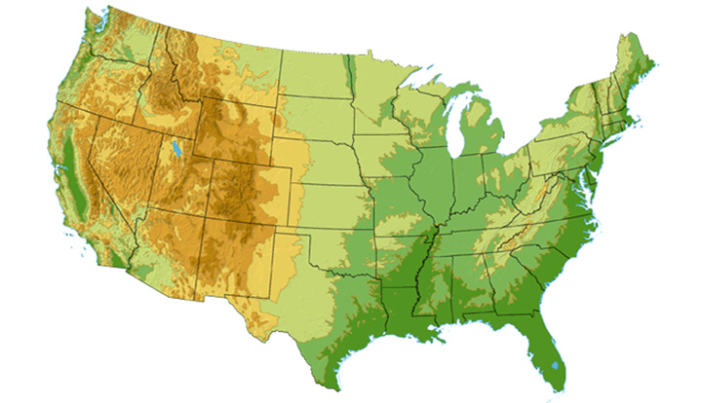









What sort of problems are solved with algorithms?
DS3 (45 Mbps)
OC3 (155 Mbps)
OC12 (622 Mbps)
OC48 (2.4 Gbps)
Seattle
Tacoma
Stockton
Cheyenne
Chicago
New York
Pennsauken
Relay
San Jose
Kansas City
Roachdale
Wash. DC
Anaheim
Atlanta
Fort Worth
Orlando
Internet - Manage and manipulate data
E.g., (1) search engines, (2) finding good routes on which data will travel

Slide 7
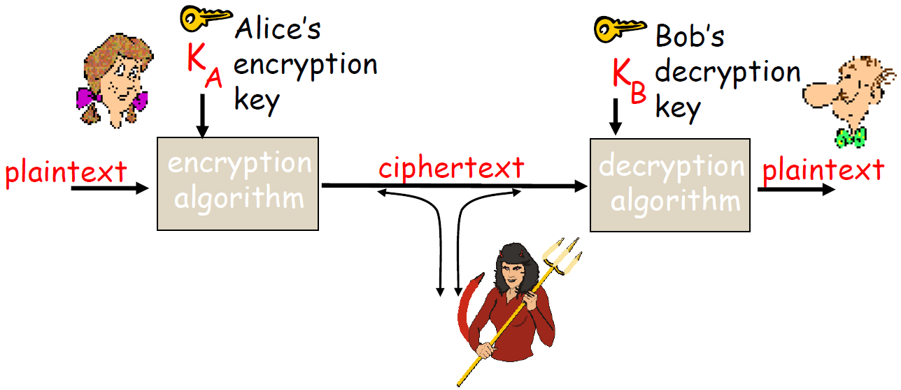
What sort of problems are solved with algorithms?
ujner@ si emosewa¡
Renju is awesome!
Renju is awesome!
Data security – cryptography
Encryption algorithm
→ computational steps to transform plaintext to ciphertext
Decryption algorithm
→ computational steps to transform ciphertext back to plaintext

Slide 8

What sort of problems are solved with algorithms?
Scheduling problems
E.g., Flight scheduling
Crew preferences
Airplane types
Weather
Fuel Costs
Delays
From http://www.worldofstock.com/slides/TRA2599.jpg

Slide 9
Agenda (Morning)
What sort of problems are solved with algorithms?
Common Data Structures in Programing
Queue, Stack, Linked List, Tree, Graph
Search Algorithms
Sequential Search
Time Complexity and Space Complexity
Binary Search [Exercise ]
Sorting Algorithms
Bubble Sort [Exercise ]
Insertion Sort
Selection Sort
Quick Sort
Merge Sort [Optional Exercise ]

Slide 10
Common Data Structures in Programming
Queue: a first-in first-out list
What will the output be?
Figure source: https://en.wikipedia.org/wiki/Queue_(abstract_data_type)

Slide 11
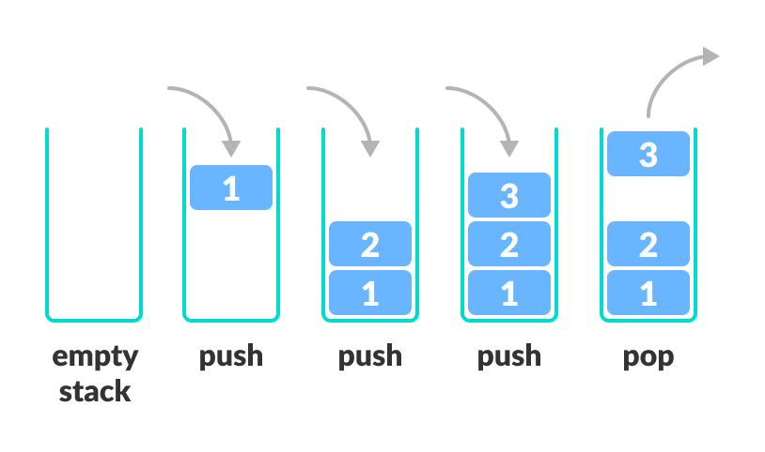
Common Data Structures in Programming
Stack: a first-in last-out list
The only difference is you remove the most recent element.
Exercise: How to convert the code for a queue into code for a stack?
Figure source: https://www.programiz.com/dsa/stack

Slide 12
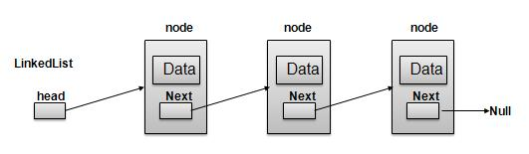
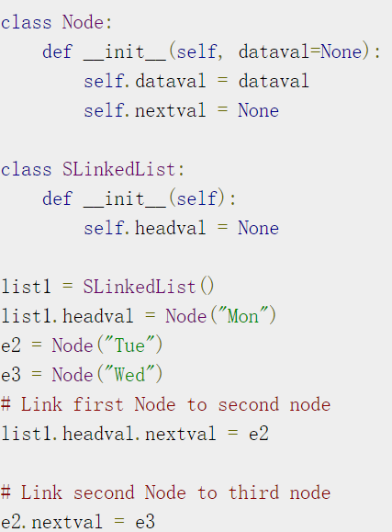
Common Data Structures in Programming
Queue: sequence of data structures which are connected via links
Mon
Tue
Wed
Mon
Tue
Wed
Mon
Tue
Wed
Figure source: https://www.tutorialspoint.com/data_structures_algorithms/linked_lists_algorithm.htm

Slide 13
Common Data Structures in Programming
Tree: simulates a hierarchical tree structure, with a root value and subtrees of children with a parent node, represented as a set of linked nodes.
A
B
C
D
E
F
G
H
I
J
K
L
M

Slide 14
Common Data Structures in Programming
Graph: a set of vertices and edges
We will talk about details in the afternoon class
A
B
JFK
C
LAX
LAX
STL
D
E
HNL
DFW
FTL
Other data structures: Heap, Hashing, Strings, etc.

Slide 15
Agenda (Morning)
What sort of problems are solved with algorithms?
Common Data Structures in Programing
Queue, Stack, Linked List, Tree, Graph
Search Algorithms
Sequential Search
Time Complexity and Space Complexity
Binary Search and Binary Search Tree [Exercise x2]
Sorting Algorithms
Bubble Sort [Exercise ]
Insertion Sort
Selection Sort
Quick Sort
Merge Sort [Optional Exercise ]

Slide 16

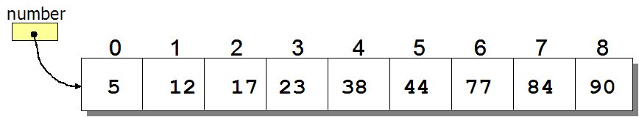
Search Algorithms
How to search for an element in a list?
Sequential search: Go through each element and check if it is the required element
Best case?
Worst case?
What if the list is sorted?
Can we do better?
Source: http://www.spinachandyoga.com/how-to-deal-with-a-long-to-do-list-with-zen/
Source: http://www.csit.parkland.edu/~mbrandyberry/CS1Java/Lessons/Lesson27/BinarySearch.htm

Slide 17
Time-Complexity: Upper Bound O-notation
for i = 0 to n
a = a + 1
for i = 0 to n
for j = 0 to n
a = a + 1
O(n)
O(n²)
Algorithm X executes in 10n² + n / 3.7 + 22 steps → O(n²)
Algorithm Y executes in 100n log n + 14n + 22 steps → O(n log n)
Which algorithm is better?
Other notations: asymptotically tight bound Θ-notation
lower bound Ω-notation
Algorithm Y

Slide 18
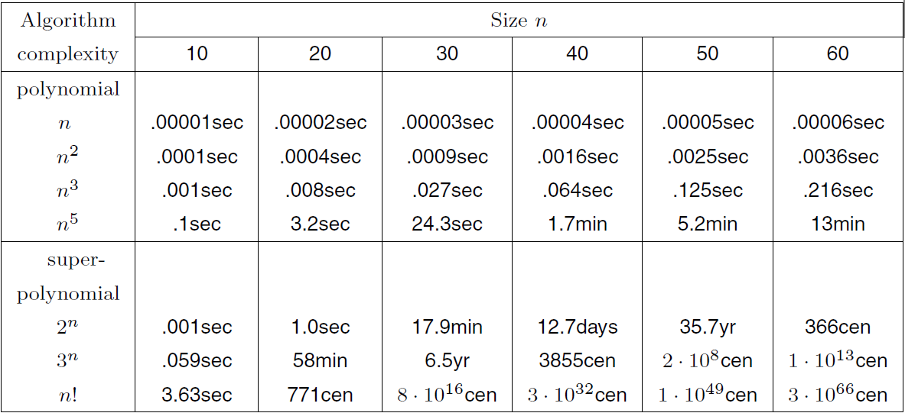
Running Time Comparison
Good
Bad!

Slide 19
Space-Complexity
Similar to time complexity, but measures the extra space (memory) used:
e.g. a list L whose length is N
Create 100 new variables: O(1)
Duplicate this list: O(N)
Create a NxN matrix M, M(i,j) = L(i) – L(j): O(N²)

Slide 20
Search Algorithms
How to search for an element x in a list?
Sequential search: Go through each element and check if it is the the required element
Best case?
Worst case?
What if the list is sorted?
Can we do better?
YES
BINARY SEARCH
Source: http://www.spinachandyoga.com/how-to-deal-with-a-long-to-do-list-with-zen/

Slide 21
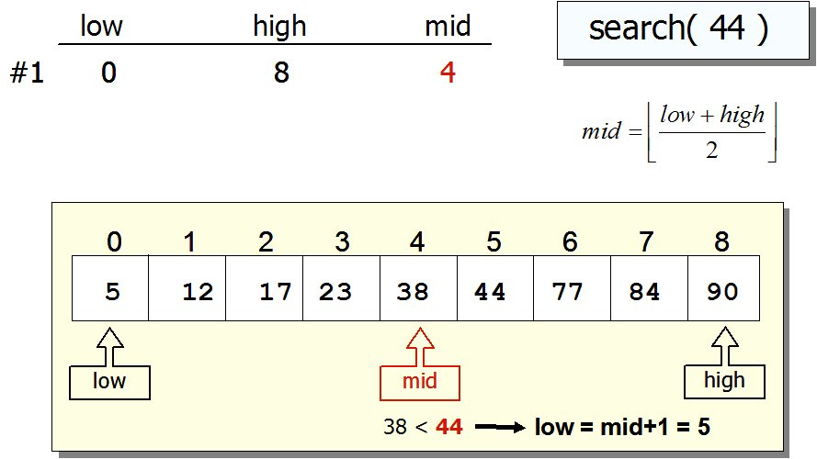
Search Algorithms: Binary Search
If list is sorted:
Split list into two halves. If x is greater than element in the middle, then discard the left half. Otherwise discard the right half. Repeat until you find x.
Source: http://www.csit.parkland.edu/~mbrandyberry/CS1Java/Lessons/Lesson27/BinarySearch.htm

Slide 22
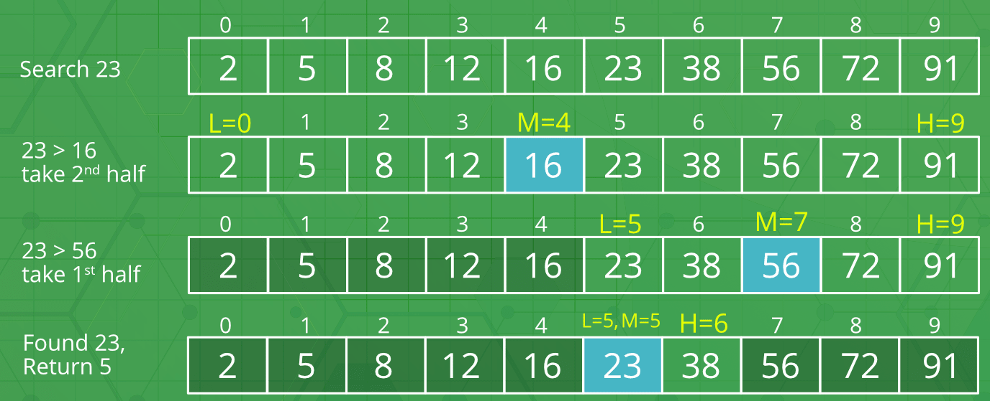
Search Algorithms: Binary Search
If list is sorted:
Split list into two halves. If x is greater than element in the middle, then discard the left half. Otherwise discard the right half. Repeat until you find x.
Sourcehttps://www.geeksforgeeks.org/binary-search/

Slide 23
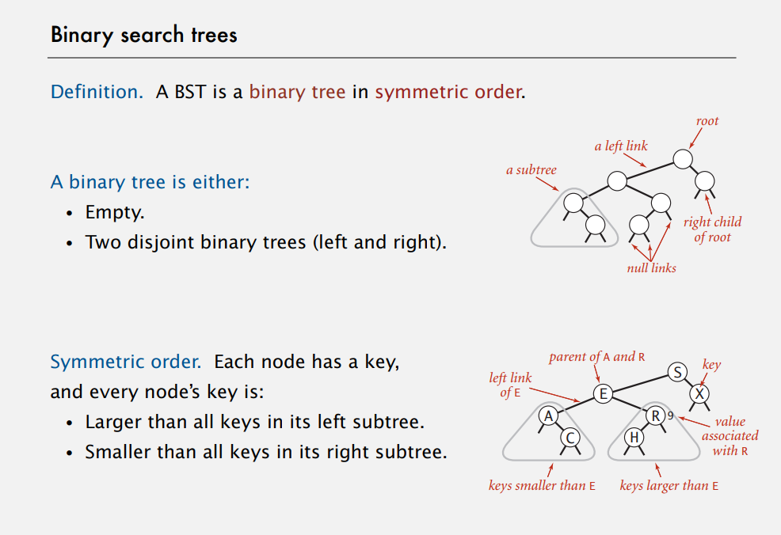

Slide 24
Search Algorithms
Deal with large amount of unsorted data and numerous quries
Other Data Structure?
Binary Search Tree

Slide 25
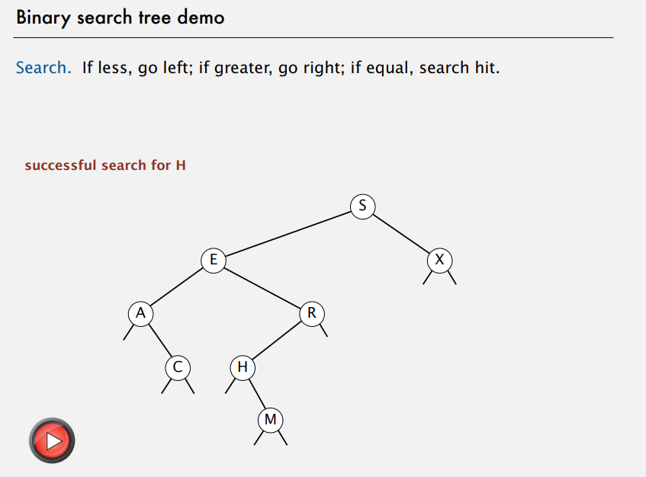

Slide 26
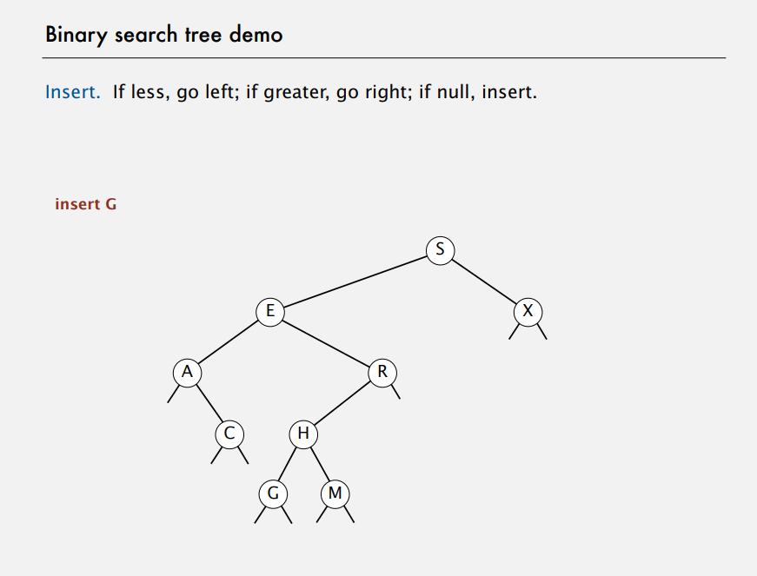

Slide 27
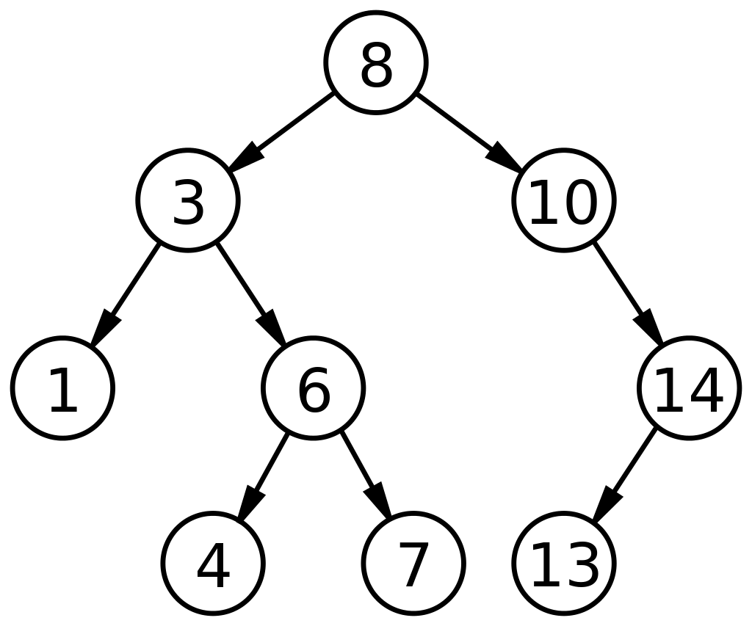
Deletion is More Difficult
(1) A leaf node is to be deleted: Direct delete
(2) The node to be deleted has only one child

Slide 28
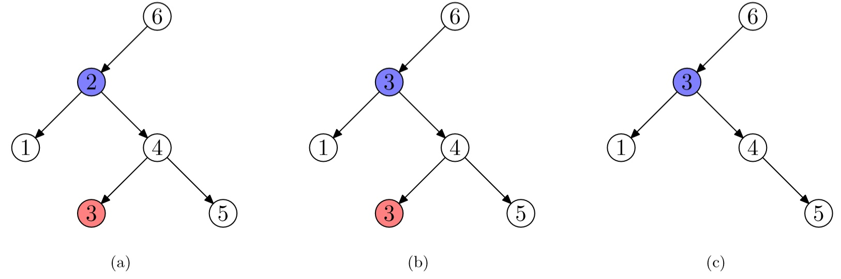
Deletion is More Difficult
(3) A node has two children to be deleted
Find the smallest value in the right sub-tree
Replace the target value with this smallest value
Delete the node for the smallest value

Slide 29
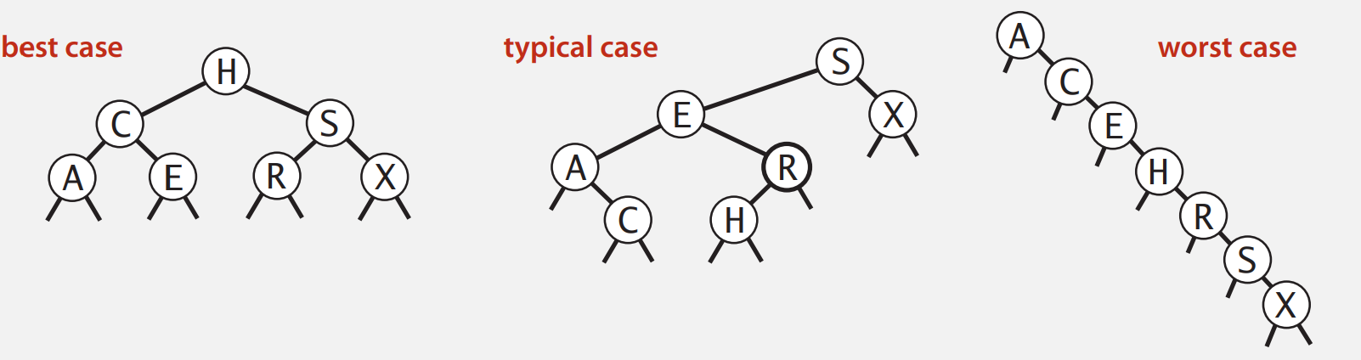
Limitations of BSTs
Modifications: Self-balancing binary search tree, Red-black Tree

Slide 30
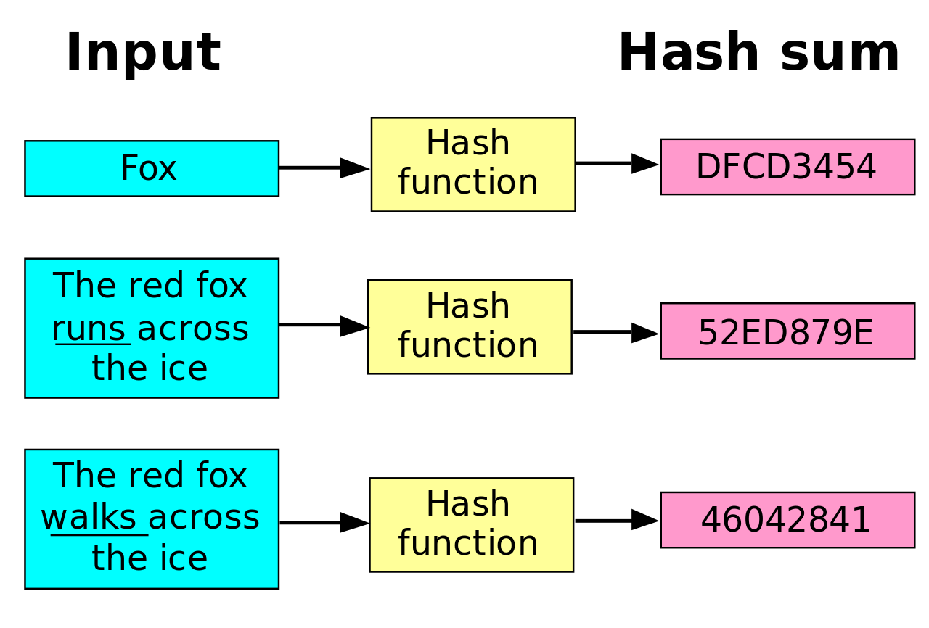
Other Solutions: Hash Functions
https://en.wikipedia.org/wiki/Hash_function

Slide 31
Agenda (Morning)
What sort of problems are solved with algorithms?
Common Data Structures in Programing
Queue, Stack, Linked List, Tree, Graph
Search Algorithms
Sequential Search
Time Complexity and Space Complexity
Binary Search [Exercise ]
Sorting Algorithms
Bubble Sort [Exercise ]
Insertion Sort
Selection Sort
Quick Sort
Merge Sort [Optional Exercise ]

Slide 32
Sorting Algorithms
Sorting algorithm is an algorithm that puts elements of a list in a certain order
Sorting is a fundamental operation in computer science and algorithms
Many algorithms use it as an intermediate step
There are several sorting algorithms, differing in their efficiency.

Slide 33
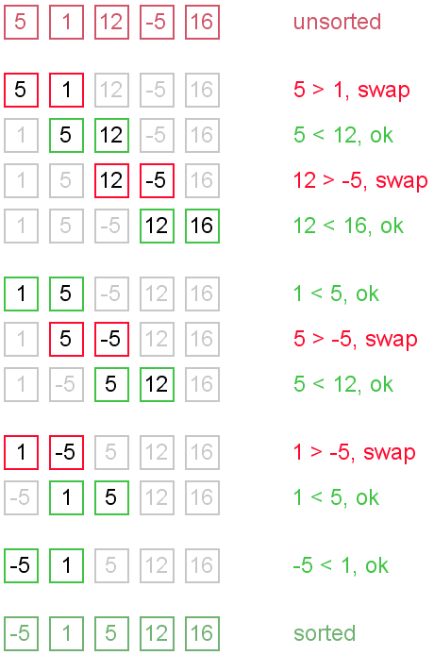


Bubble Sort
Go through the list:
If the next element is smaller:
SWAP!

Slide 34
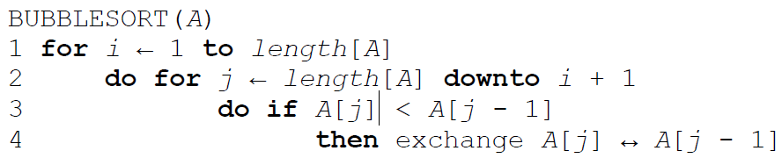
Bubble Sort

Slide 35
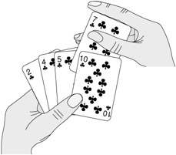
Insertion Sort
Start with empty left hand
Pick one card at a time
Insert it into the correct position in left hand
To find correct position, compare it with each of the cards already in hand

Slide 36
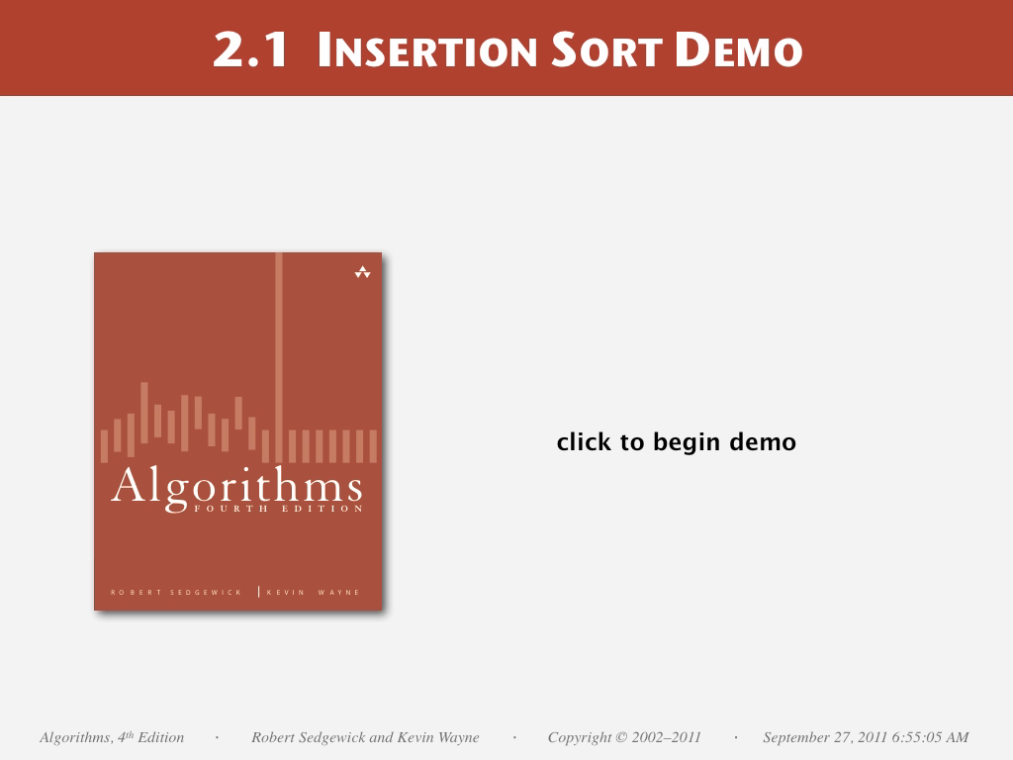

Slide 37
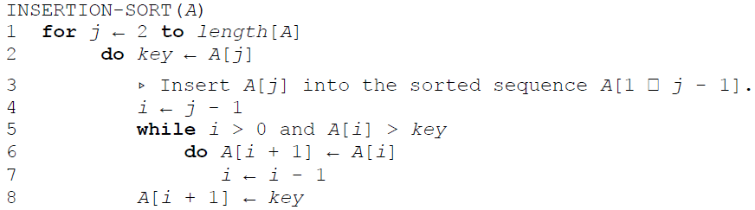
Insertion Sort

Slide 38
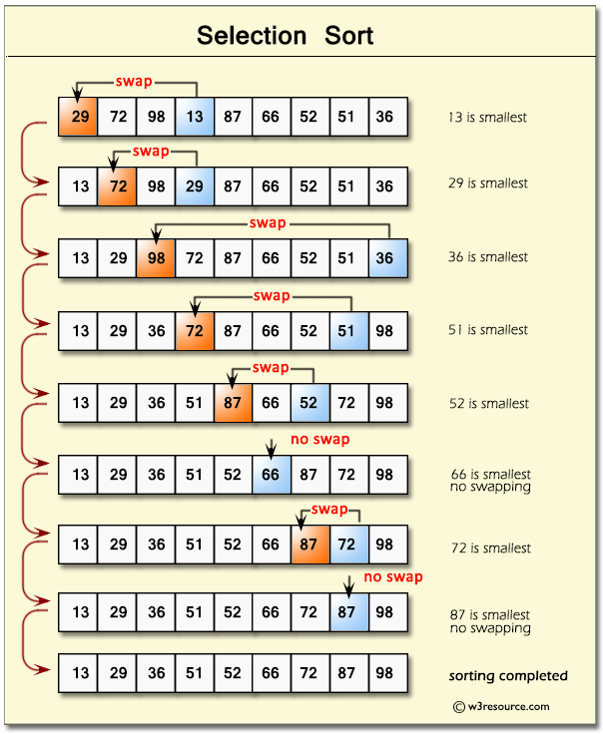
Selection Sort
In iteration i, find index of the smallest entry in unsorted part of the list
Swap a[i] and a[min]
i ← i + 1
Notes:
Bubble sort
Insertion

Slide 39


Slide 40
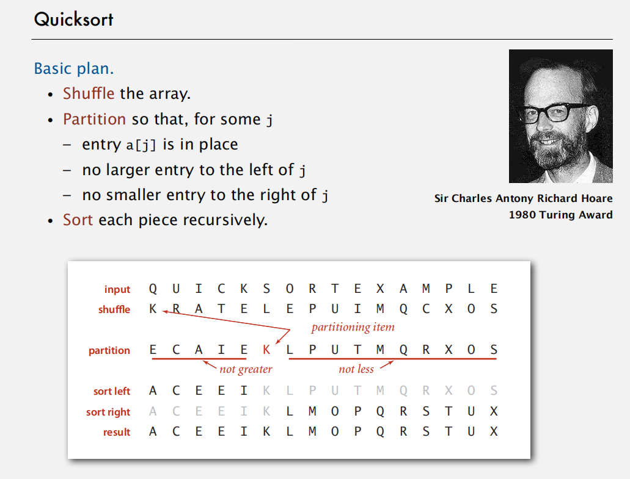
Quick Sort

Slide 41
Quick Sort Partitioning Demo
23DemoPartitioning.pdf

Slide 42
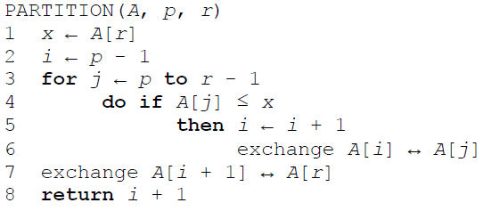
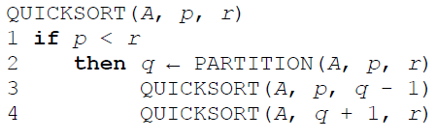
Quicksort

Slide 43
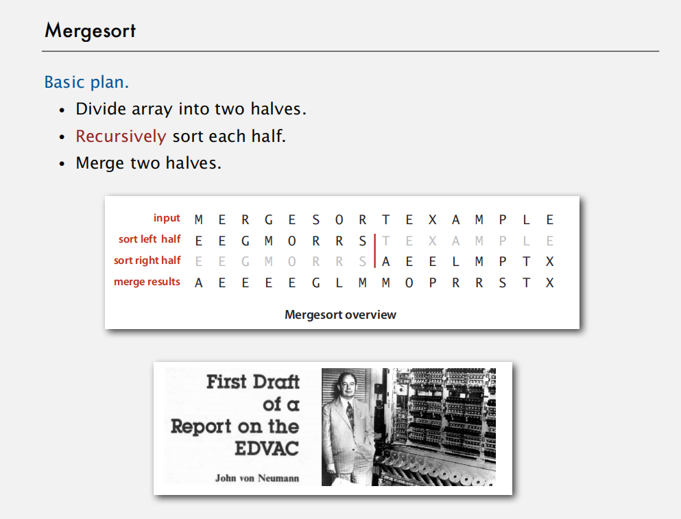

Slide 44
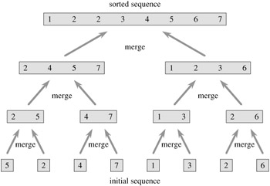
Merge Sort
Divide and conquer algorithm
Recursive algorithm
Split the list
Apply merge sort to the smaller list
After the smaller lists are collected: MERGE
(Note that each of the sublists is already sorted)

Slide 45
Exercise: Bubble sort and comparison to Python sorting algorithm
Binary Search:
https://leetcode.com/problems/binary-search/
Bubble Sort:
Optional: Merge Sort
https://leetcode.com/problems/sort-an-array/
Binary Search Tree
https://leetcode.com/problems/search-in-a-binary-search-tree

Slide 46
Time for some exercise and discission.

